Slide 1
Zoning District Prediction using Data Mining Techniques
Daniel Le

Slide 2
Introduction
Research with Dr. Jelena Tesic’s Group
Process and clean City of Austin data for input into deep learning model
Planimetric Data
Aerial Imagery
This project is part of the exploratory data analysis and knowledge discovery
Want to see what we can learn about the data before deep learning

Slide 3
Datasets
City of Austin Planimetric Data (n = 21,837)
Contains manually labelled and digitized urban features for the entire City of Austin
38 different features, including, but not limited to:
Structures, Paved Parking, Paved Road, Unpaved Road, Open Space, Gravel/Sandpit, Golf Course, Recreational Area, Athletic Field, Patio, Landfill
City of Austin Neighborhood Planning Boundaries
Boundaries of Neighborhoods in Austin (Used to reduce dataset)
City of Austin Zoning Districts (n = 2,410,915)
Boundaries of 39 different zoning districts in Austin.
Goal is to predict a zoning district

Slide 4
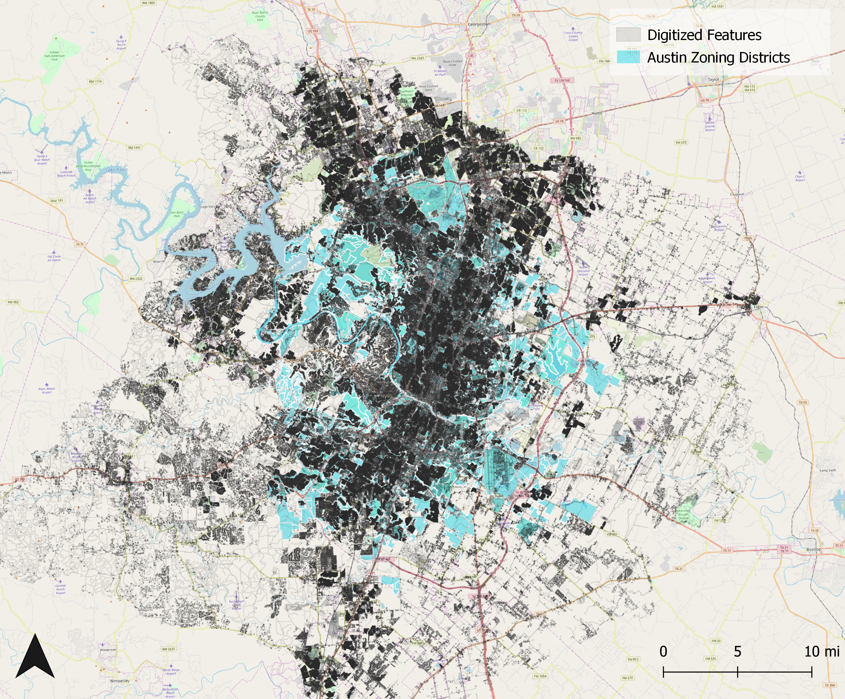

Slide 5
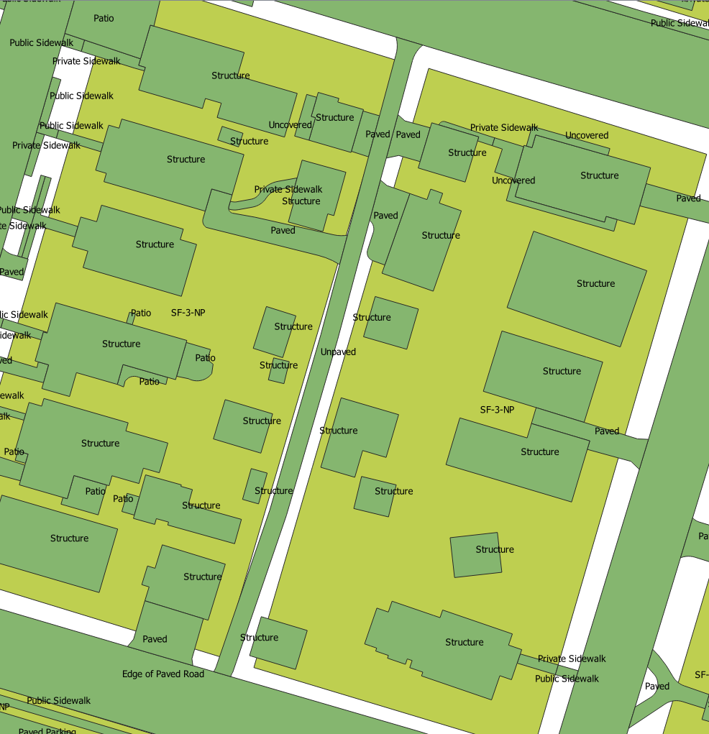
Data Processing Workflow
Issues
Features that are very long cannot be used
Processing time is too long to “cut” each polygon feature to each zone
Did not have time to find faster processing method
Only took features where the area is smaller than the zone area
Use QGIS for feature generation:
For every zone
Count number of features for each unique class
Calculate total area for each class
Example:
Commercial Zone
6 structures
Area (Structure) / Area of Zone = 10%

Slide 6
Feature Generation
Used Jupyter Notebook for Data Analysis and Exploration
Raw data contains X = 66 features
Some features can be combined together
List the # of labels (unbalanced data)

Slide 8
Results
Issues
Features that are very long cannot be used
Processing time is too long to “cut” each polygon feature to each zone
Did not have time to find faster processing method
Only took features where the area is smaller than the zone area
2013 Data

